Slide 1
Final Project Predicting Energy Consumption based on Weather Forecasts Presentation
Chris Kellam, Eric Lidiak, Matthew Smith, Molly Fox, Jason Britton

Slide 2
Project Summary
TOPIC: Predicting Energy Consumption based on Weather Forecasts
DESCRIPTION
Create a predictive model based on historical weather and energy consumption data to forecast energy consumption based on weather variables such as minimum, maximum and average temperature, state, and month of year.
RESEARCH QUESTIONS
What types of historical data are available for weather and energy consumption?
Is weather data a good predictor of energy consumption?

Slide 3
Data and Delivery
Datasets
Energy Data: U.S. Energy Information Administration https://www.eia.gov
Weather Data: https://asmith.ucdavis.edu/data/prism-weather
Each team member took a potential model library (ARIMA, Prophet, Random Forest, LSTM, XGBoost) to compare and contrast the libraries predictive power using the two data sets.
The weather data began in January 1981 and continued through December 2023. The energy data began in January 2001 and continued through September 2024. We narrowed the scope of the combined data from January 2001 to December 2023.
Preprocessing was conducted jointly and individually based on the needs of the various models.

Slide 4
Model Accuracy
ARIMA
Prophet
Random Forest
LSTM
XGBoost: 81.18% Accuracy with a RMSE value of 2576.06

Slide 5
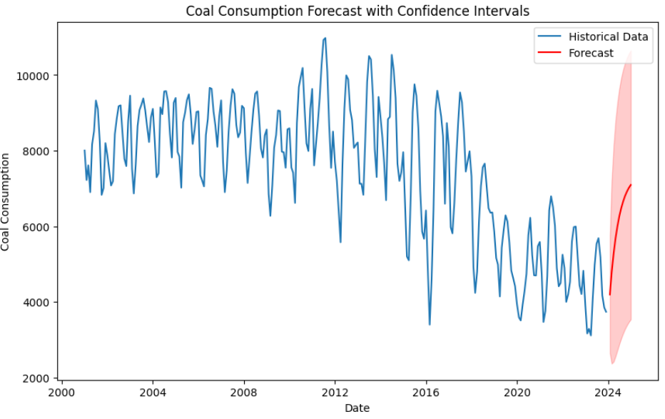
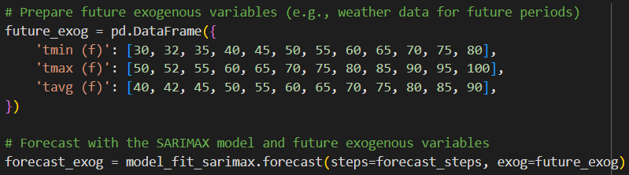
Model: ARIMA
The ARIMA model had an average RMSE value of 1771.17, Mean Absolute Error of 1494.48, and R-squared value of 0.06 (indicating the model explains only about 6.32% of the variability in coal consumption).
Auto-ARIMA was used to find the best parameters. “ARIMA(2,1,1)(0,0,0)[0]” was identified to be the best model.
The model was asked to predict coal consumption for January to May 2024 based off of data from January 2001 to December 2023:
Predicted coal consumption
January 2024 | 4193
February 2024 | 4789
March 2024 | 5276
April 2024 | 5673
May 2024 | 5998

Slide 6
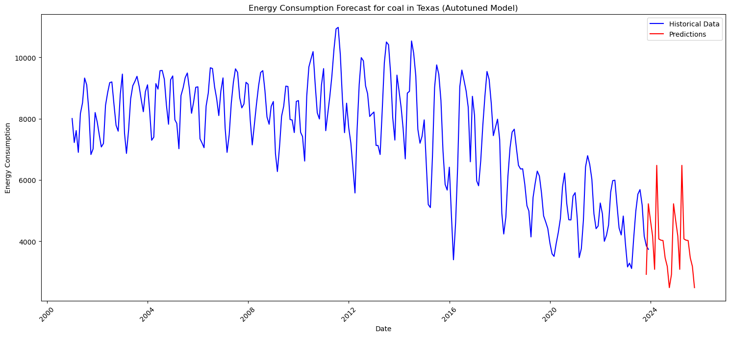
Model: XGBoost
The XGBoost model had a predictive accuracy of 81.18% with an average RMSE value of 2576.06.
Autotuning was used for dialing the model in. The best parameters were: {'subsample': 1.0, 'n_estimators': 2000, 'min_child_weight': 5, 'max_depth': 5, 'learning_rate': 0.3, 'colsample_bytree': 1.0}
Given values for Texas in December 2023 for the various features:
'year': [2025], 'month_num': [12], 'tmin': [2.652], 'tmax': [15.471], 'tavg': [9.062], 'ppt': [94.212]
The model was asked to predict coal consumption for Texas in December 2025. The model predicted a value of 2871
thousand tons. The actual coal
consumption for Texas in December
2023 was 3736. A difference of 865
thousand tons.

Slide 7
Key Observations
Weather data is a decent predictor or energy consumption based on the models’ predictive capabilities…

Slide 8
Thank You

